Slide 1
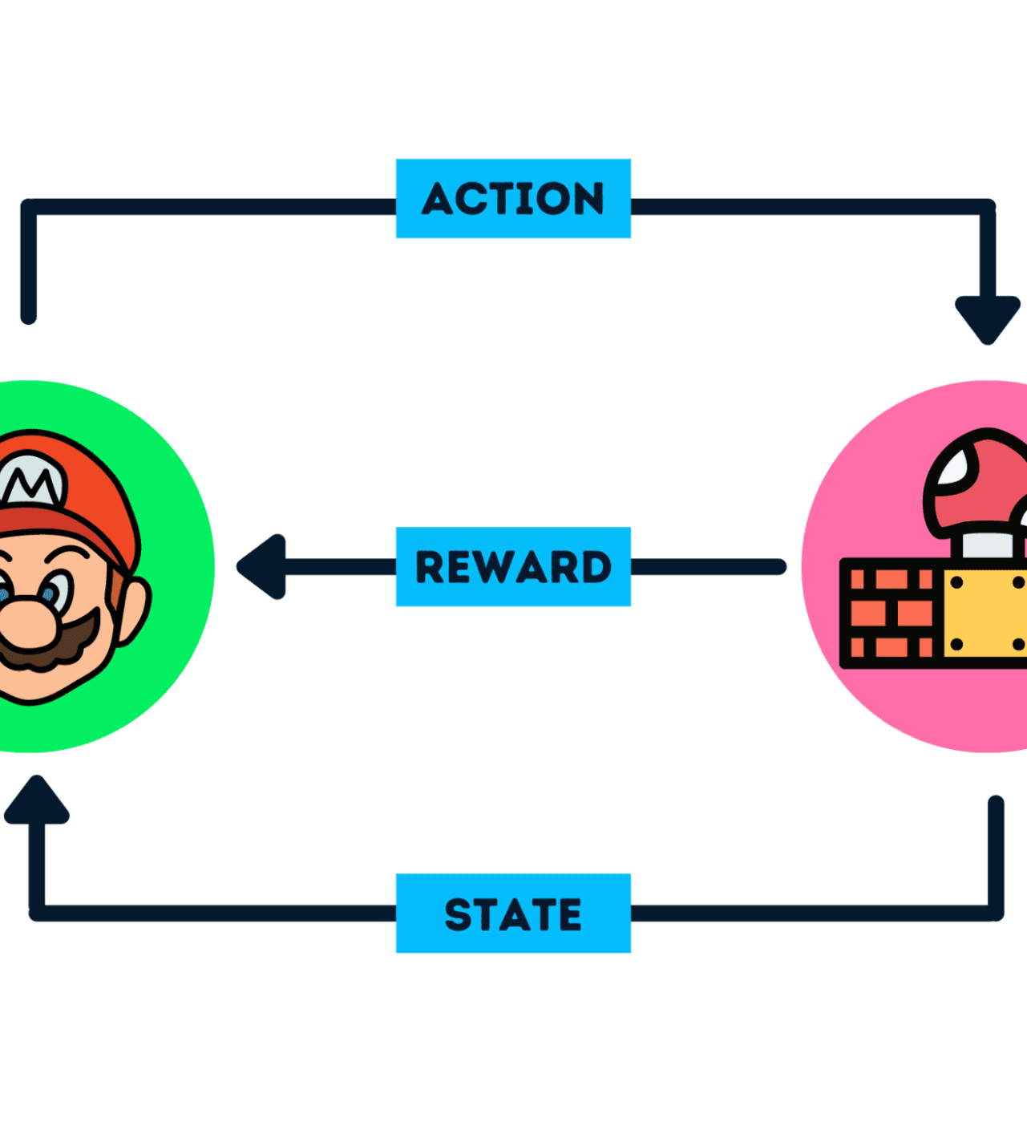
Paper Talk: “Go with the Flow - Reinforcement Learning in Turn-Based Battle Video Games”
Authors: Elinga Pagalyte, Maurizio Mancini, Laura Climent
Venue: IVA 2020
Presented by Joseph Nikhil Reddy Maramreddy
Presented as part of the Final Project for course CS 5325.001

Slide 2
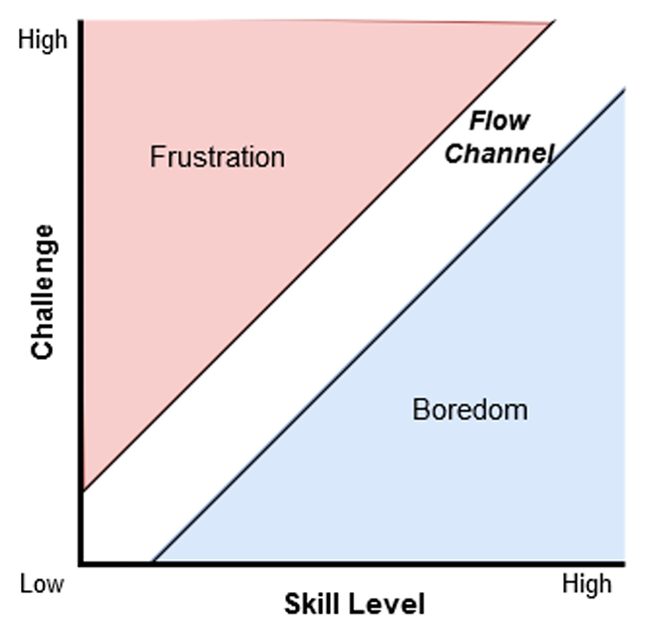
Motivation & Problem Statement
Traditional games use fixed difficulty levels (Easy/Medium/Hard).
These fail to adapt to each player’s skill level.
Too easy → boredom; too hard → frustration.
Dynamic Difficulty Adjustment (DDA) aims to keep players in flow - a balanced challenge.
Notes:
The authors wanted to create a game that automatically adjusts its challenge level so the player stays in the optimal zone of engagement.

Slide 3
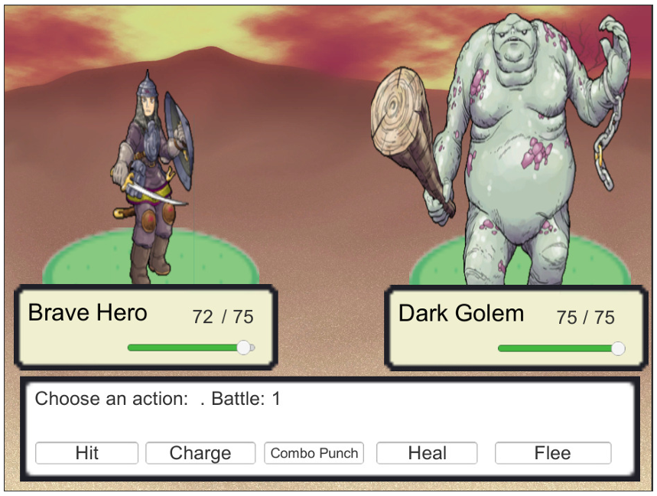
Approach Overview
Built a 2D turn-based battle game (similar to classic RPG fights).
Implemented a Reinforcement Learning (SARSA) agent as the opponent.
Used RL to adjust gameplay dynamically (learning from ongoing battles).
Evaluated both agent behavior and player engagement through experiments.
Notes:
Summarize what they did at a high level.

Slide 4
Game Mechanics
Each side (player & agent) starts with 75 HP.
Player chooses from 5 moves: Hit, Charge, Combo, Heal and Flee.
The AI also has these moves (no Flee).
Battles end when one side’s HP ≤ 0.
Notes:
Summarize what they did at a high level.

Slide 5
Reinforcement Learning Setup
Algorithm: SARSA (on-policy RL).
Q(s, a)←Q(s, a)+α[r+γQ(s′, a′)−Q(s, a)]
States: 17 discrete HP-difference bands (e.g., equal HP, player ahead, AI ahead).
Actions: Hit, Charge, Combo, Heal.
Reward:
+100 for winning, −100 for losing (or ±50 variant).
Rewards swapped after 5 wins/losses → Dynamic Difficulty Adjustment.
Notes:
Explain SARSA clearly with state/action/reward.

Slide 6
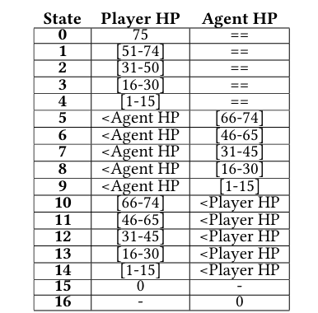
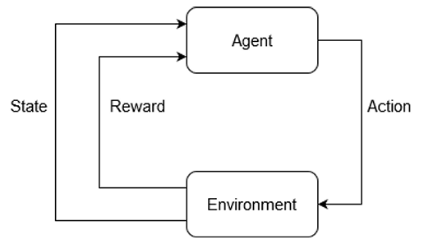
Reinforcement Learning Setup
Diagram of the SARSA algorithm.
The states for the SARSA RL agent.

Slide 7
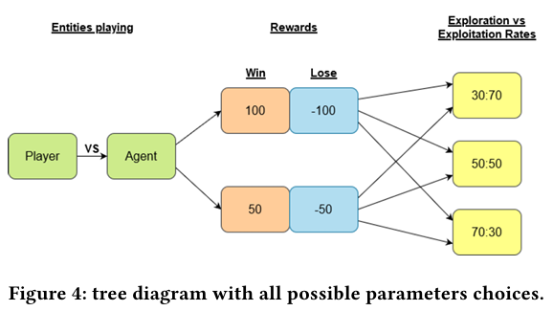
Experiment Design
Participants: 4 players (2M, 2F, ages 20 - 40).
Games: 10 game configurations (varying reward magnitude & exploration rate).
Each game: 30 battles.
Measures:
Player move usage
Agent’s action evolution
HP trends per battle
Player feedback via Game Experience Questionnaire (GEQ)

Slide 8
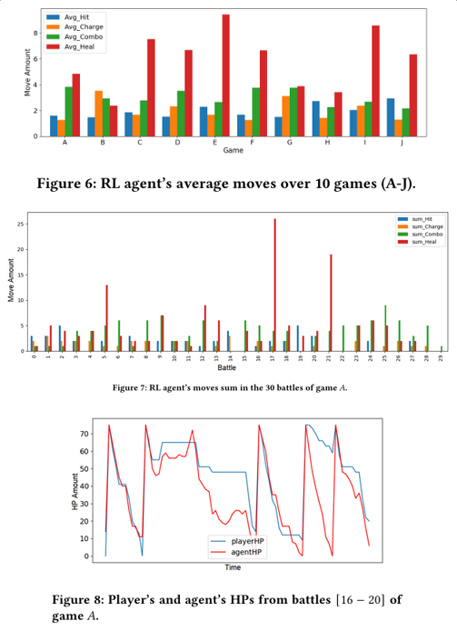
Results: Agent Learning Behavior
Early training → agent overused Heal, leading to long matches.
Later → agent learned to balance between attacking and healing.
(30% exploration / 70% exploitation) gave best results - balanced challenge.
Agent move distributions (combo, heal, etc.)
HP traces over battles (showing more balanced fights).
Notes:
Initially the agent spammed healing, but over time it learned to attack effectively, demonstrating real adaptation through experience.

Slide 9
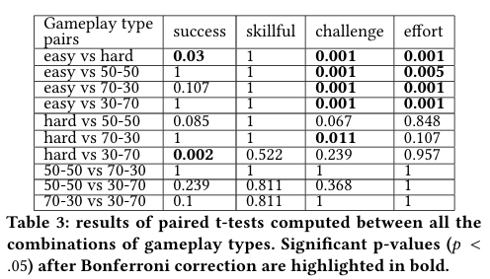
Results: Player Experience
Measured via GEQ (challenge, competence, effort, flow).
RL-based AI produced balanced challenge and engagement.
Fixed Easy AI → boring; Hard AI → frustrating.
RL opponents often scored highest for flow and enjoyment.

Slide 10
Limitations
Small state space & simple environment. Results may not scale to complex games.
Reward swapping heuristic (after 5 wins/losses) may cause abrupt difficulty shifts.
Small participant pool → limited statistical significance.
Heal-spamming artifact shows incomplete reward shaping.
No comparison to other RL methods (e.g., Q-learning).
Notes:
Their approach works, but it’s a proof of concept, scaling to richer environments would need smarter state representations and reward shaping.

Slide 11
My Implementation Plan
Implement a simplified SARSA agent in Python with:
17-state representation (HP difference).
4 actions (Hit, Charge, Combo, Heal).
Reward swapping for adaptive difficulty.
Simulate training and visualize:
Agent learning curve.
HP difference per battle.
Move distribution evolution.
If time permits, I also want to make a small project using a game engine.

Slide 12
Feasibility
Because the SARSA algorithm and state-reward structure are straightforward to implement in Python or Unity, the project requires only basic computational resources.
The RL agent operates on a discrete state-action space with small-scale training data; hence, this project is computationally feasible without GPUs or large datasets.
Any potential challenges that can arise during experiments, such as reward tuning or overuse of specific actions (e.g., Heal), can be managed through controlled simulation and logging.

Slide 13
Thank You!
Open to Questions :)
Joseph Nikhil Reddy Maramreddy – yue15
CS 5325.001 – Reinforcement Learning
Citation: Elinga Pagalyte, Maurizio Mancini, and Laura Climent. 2020. Go with the Flow: Reinforcement Learning in Turn-based Battle Video Games. In Proceedings of the 20th ACM International Conference on Intelligent Virtual Agents (IVA '20). Association for Computing Machinery, New York, NY, USA, Article 44, 1–8. https://doi.org/10.1145/3383652.3423868

